Slide 1
PRACTICE 1
Using FLEX to make it RESPONSIVE

Slide 2
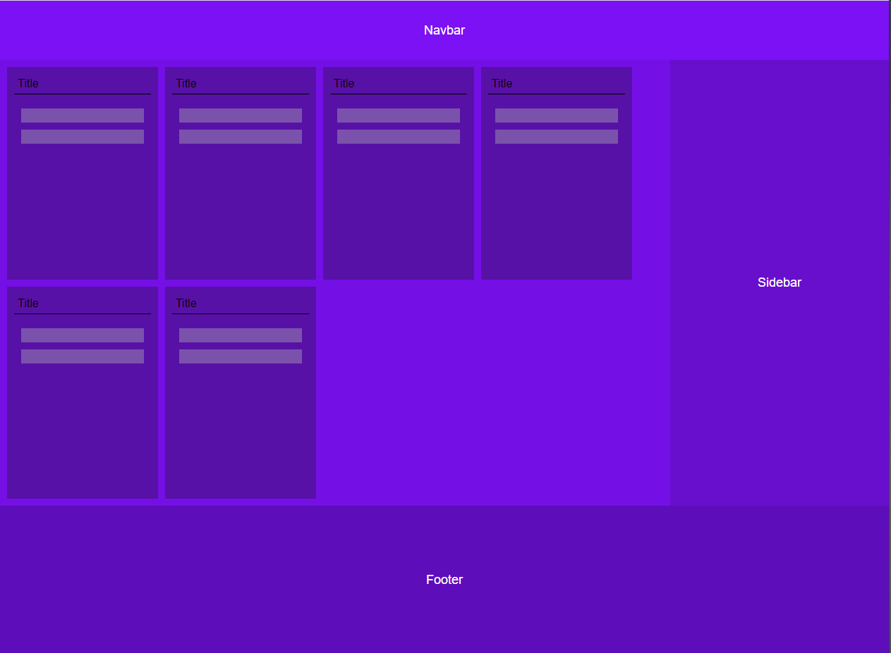
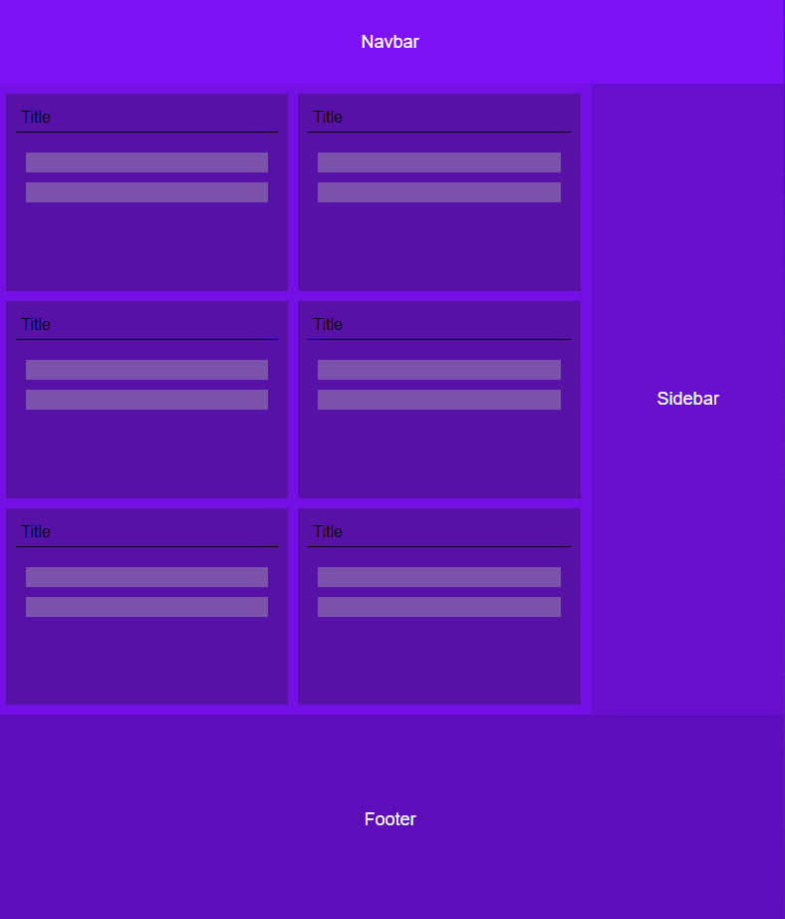
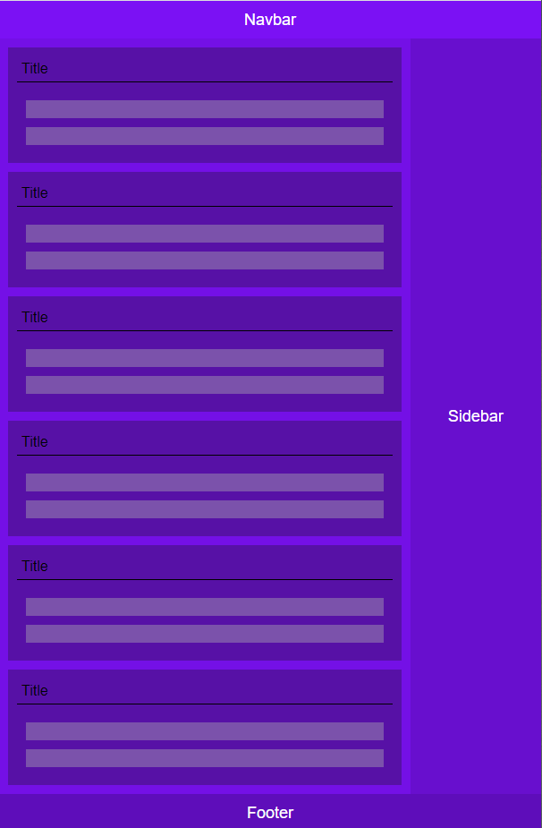
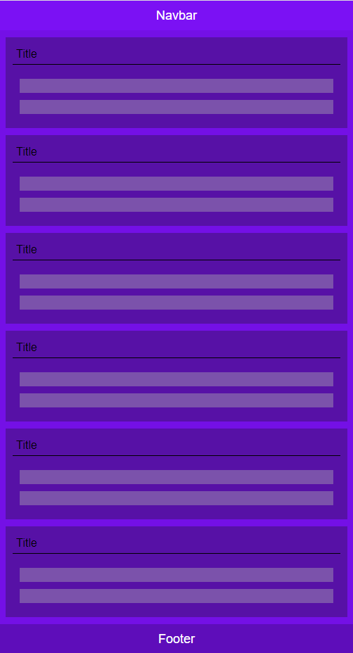
Default
max-width:800px
max-width:700px
max-width:600px

Slide 3
PRACTICE 2
Using FLEX to make it RESPONSIVE

Slide 4
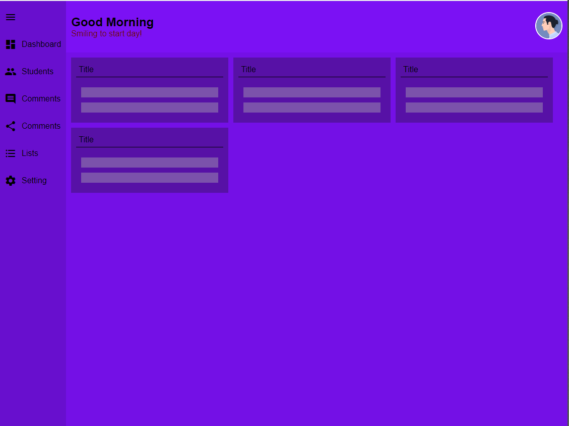
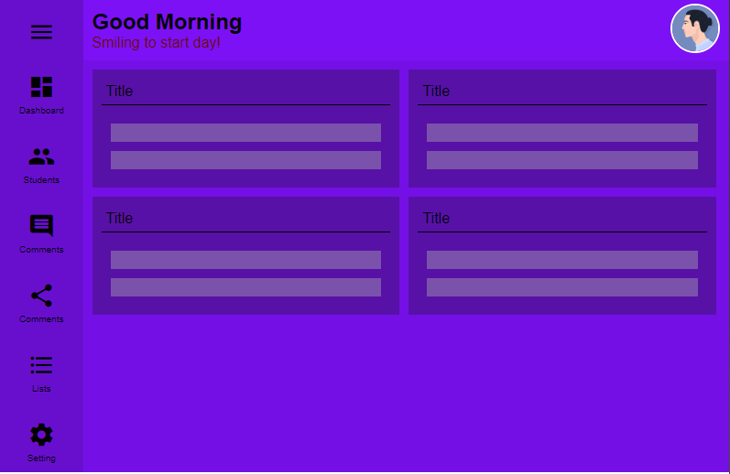
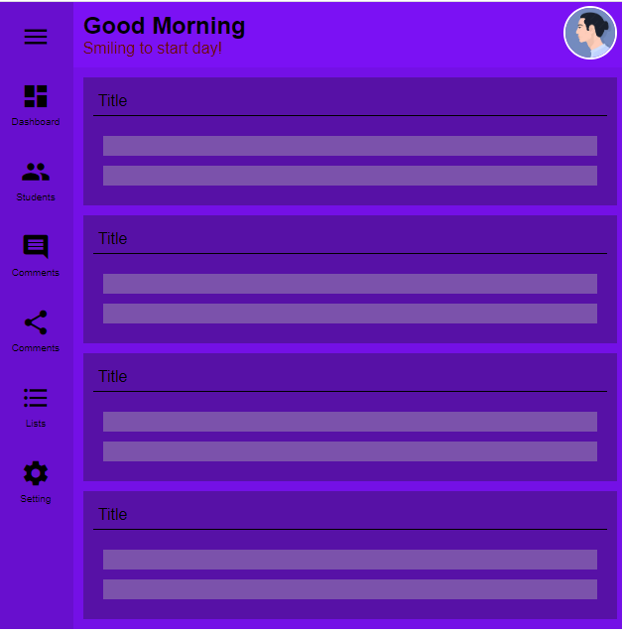
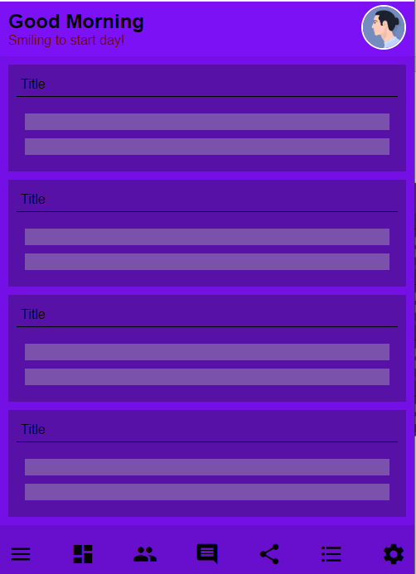
Default
max-width:800px
max-width:700px
max-width:600px

Slide 5
PRACTICE 3
Using FLEX to make it RESPONSIVE

Slide 6
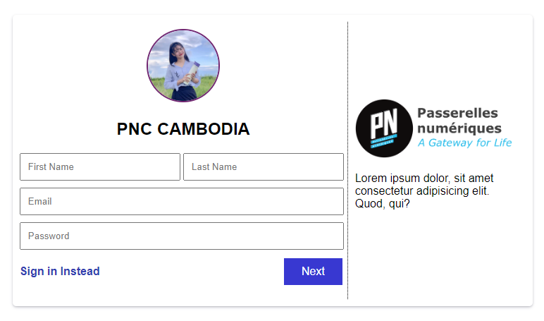
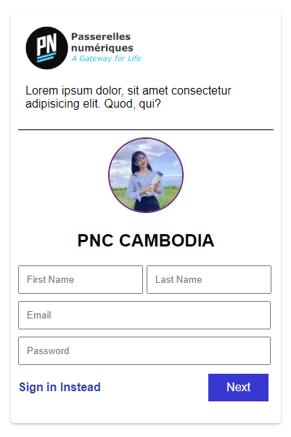
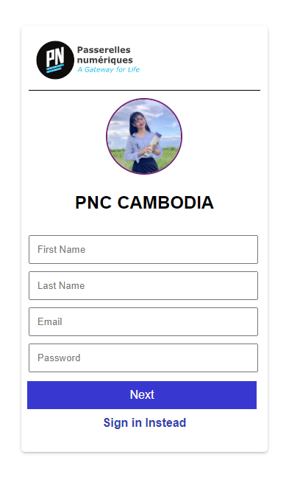
Default
max-width:768px
max-width:600px

